Slide 1
Transfer learning – Next big thing
PRESENTED BY -
Aayush Agrawal

Slide 2


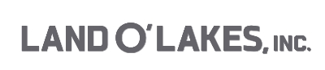




Aayush Agrawal
Education -
MS in Business Analytics, Carlson School of Management, University of Minnesota, 2017
B.Tech in Electrical Engineering, Malaviya National Institute of Technology, India, 2013
Experience –
>4 years in Data science, Currently working as Data scientist for Land O’ Lakes, Inc.
Moderator and rank 3rd at https://www.analyticsvidhya.com/
Kaggle Expert - https://www.kaggle.com/aayushmnit
Reach me out at (@aayushmnit) –
Email - aayushmnit@gmail.com
LinkedIn - https://www.linkedin.com/in/aayushmnit/
Github - https://github.com/aayushmnit

Slide 3
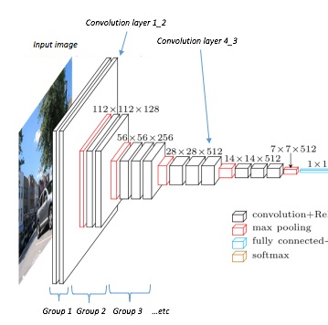


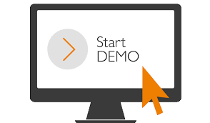
Agenda
Introduction to CNN’s
What/WHY
Transfer learning?
Examples
How to do
Transfer learning

Slide 4

Traditional NN don’t scale well to full images
Consider an image of size 32*32*3 (CIFAR-10 images), each neuron have 32*32*3 = 3072 weights
A low resolution image these days are around 200*200*3 while leads to 120,000 weights
Also we need more than one neuron obviously
We also need more than one layer
Notes:
Source – keras.io

Slide 5
Convolution NN takes advantage that input consists images
Typically a ConvNets will consist of three layers
Convolutional Layers
Pooling layer
Fully – Connected layer
Basic architecture - [INPUT - CONV - RELU - POOL - FC]
Convolution layer will compute the output of neurons that are connected to local regions in the input, each computing a dot product between their weights and a small region they are connected to in the input volume (https://distill.pub/2016/deconv-checkerboard/)
Relu layer will apply an elementwise activation function, such as the max(0,x) thresholding at zero.
Pool layer will perform a downsampling operation along the spatial dimensions (width, height)
Fully connected layer will compute the classes. Each neuron in this layer is connected to all the inputs
Notes:
Source – keras.io

Slide 6

A basic VGG16 architecture
Notes:
Source – keras.io

Slide 7
Agenda
Introduction to CNN’s
What/WHY
Transfer learning?
Examples
How to do
Transfer learning

Slide 8
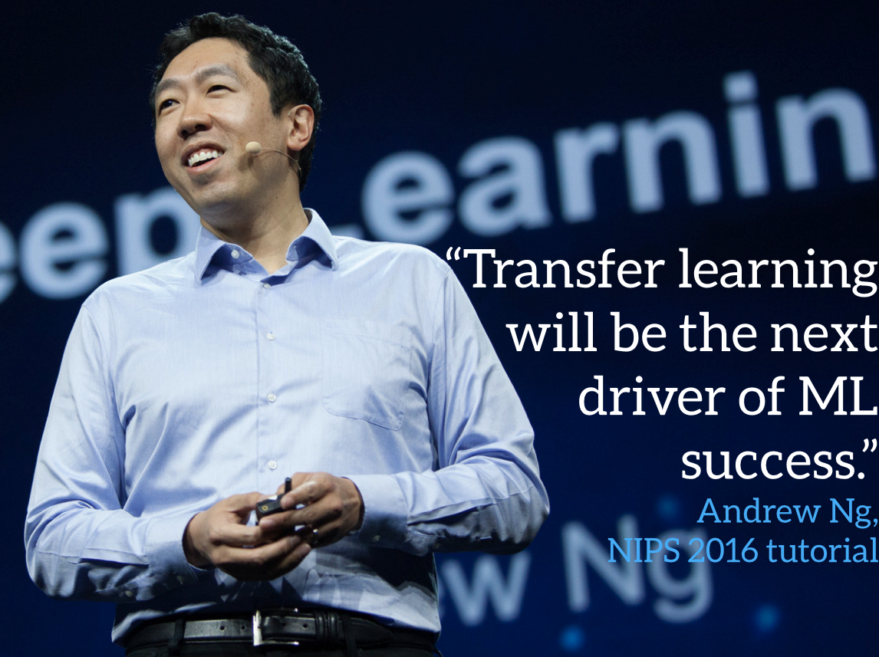
Because Andrew NG said so ….
Notes:
Source – keras.io

Slide 9
Classic machine learning requires retraining from start
Input for Task B
Input for Task A
Training and Evaluation on same task and domain
Model A
Model B
Notes:
Source – keras.io

Slide 10
Transfer learning allows to transfer knowledge from one task to another
Source Task A
Target for Task B
Storing knowledge gained solving one problem and applying it to a different but related problem
Model A
Model B
Knowledge
Notes:
Source – keras.io

Slide 11
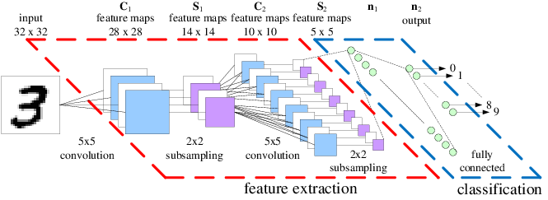
A large part of ConvNet is transferable
Generic and can be transferred
Task specific
Notes:
Source – Keras.io

Slide 12
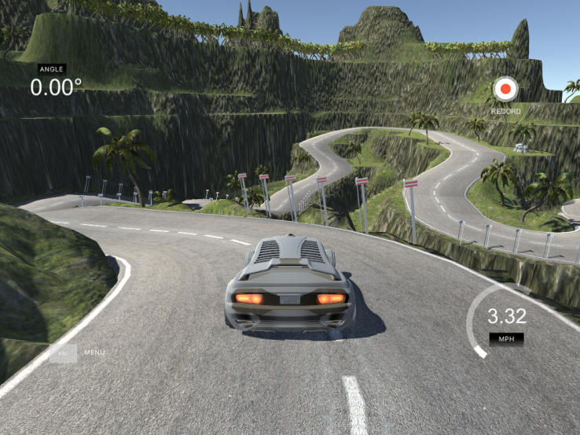
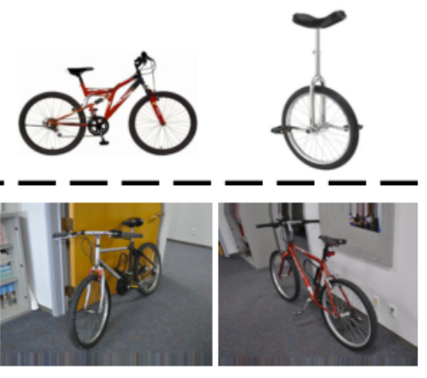
Transfer learning allows model to adapt for unseen scenarios
We don’t need extensive amount of data for a specific real scenario to train a deep learning model
Major applications of transfer learning
Learning from simulations
Self driving cars can learn from data collected from driving car in GTA5
Robotics simulation can ease the data collection process from a
real robot
Adapting to new domains
General image classification can be used to train on new domains
Speech models like Glove, Word2vec can be used to adapt to new
domain specific text
Voice recognition system built adapting to kids voice
Notes:
Source – keras.io

Slide 13
Agenda
Introduction to CNN’s
What/WHY
Transfer learning?
Examples
How to do
Transfer learning

Slide 14
Transfer learning in ConvNet
Three major transfer learning scenarios look as follows:
ConvNet as feature extractor
Take a ConvNet pretrained on dataset like ImageNet
Remove the last fully connected layer
Treat the last as a feature extractor for the new dataset
Run a linear/tree based classifier on new features
Fine Tuning the ConvNet
Replace the classifier of a Convnet saved on Imagenet
Fine tune model weights of all the layers present in the model using new dataset
Tuning the last few layers give maximum increase in accuracy
Using a pretrained model
This involves using pretrained weights of someone else to finetune the existing model
Notes:
Source - http://llcao.net/cu-deeplearning17/lecture/keras_presentation.pdf

Slide 15
When and how to finetune?
Scenario 1: New dataset is small and similar to original dataset
Recommendation: Use a Convnet as feature extractor and train a linear model on top of it, because of overfitting issues
Scenario 2: New dataset is large and similar to the original dataset
Recommendation: Fine tuning the ConvNet by adding new fully connected layer would be best as we can prevent the overfitting issues because of large data size.
Scenario 3: New dataset is small but very different from the original dataset.
Recommendation: Don’t use a pretrained model and go for linear models only
Scenario 4: New dataset is large and very different from the original dataset
Recommendation: Train a Convnet from scratch. It is very often still beneficial to initialize with weights from a pretrained model. Fine tuning the entire network is best case scenario.
Notes:
Source - http://llcao.net/cu-deeplearning17/lecture/keras_presentation.pdf

Slide 16
Practical advice/drawback using pretrained models
Constraints from pretrained models
Restricted by the architecture used for training pretrained model
You can’t arbitrarily take out Convolutional layers from the model
Learning Rates
Always start with a small learning rate for ConvNet weights that are being fine tuned
We expect ConvNet weights to be good enough to be used, so we don’t wish to distort them too quickly and too much

Slide 17
Agenda
Introduction to CNN’s
What/WHY
Transfer learning?
Examples
How to do
Transfer learning

Slide 18
Deep learning path Suggestion
Data science path - https://www.analyticsvidhya.com/blog/2017/01/the-most-comprehensive-data-science-learning-plan-for-2017/
My Deep learning track –
Machine learning by Andre NG(his first course and the most popular course in MOOC history) -> https://www.coursera.org/learn/machine-learning (Low difficulty)
Deep learning by Google on udacity - https://www.udacity.com/course/deep-learning--ud730 (Hard)
Practical deep learning for Coders by Jeremy Howard (Former Kaggle #1) - http://course.fast.ai/ (Medium/Hard)
A book on deep learning (Goodfellow) - http://www.deeplearningbook.org/ (If you need to understand deep math)
Andrew NGs deep learning track - https://www.coursera.org/specializations/deep-learning (easy/medium)
Just some collection of good blogs - http://colah.github.io/
Notes:
Source - https://www.cs.toronto.edu/~frossard/post/vgg16/

Slide 19
References for transfer learning used in presentation
http://ruder.io/transfer-learning/
http://cs231n.github.io/transfer-learning/
http://course.fast.ai/
https://github.com/fastai/courses

Slide 20
Thank You!

